Slide 1
Staff Management
Technical Design

Slide 2
Major Challenges today
Staff & Customer account have no relation between them.
Difficult to track staff involvement using Customer activities and hence Insufficient reporting.
Not able to add hierarchy to Sales Team
Plethora of google sheets used by Sales team to track progress.

Slide 3
What’s required?
Link Staff & Customer accounts
Multiple Phone number support for Staff and customers
Concept of Network, Department, Teams to be added
Improved reporting

Slide 4
Functionalities
Phase 1
Create Staff account and associate it with Customer account
Combined view Staff & Customers
View all staff
View teams
Move individuals between teams
Phase 2
Activity / audit log changes
New team structure
Add new team
Page or editing departments and job titles

Slide 5
Wireframes
Link

Slide 6
Database Schema
To Update:
Manager
User
PreOrder
Order Item
To Create:
MobileNetworkOperator PhoneNumber
JobTitle
Network
Department
Team
TeamMoves
SupervisorMoves
To Delete:
EmployeeSalesRole
SignupSalesChannel
Details - Google sheet with all model changes

Slide 7
Base Tables
MobileNetworkOperator
MobileNetworkOperator would be managed independently and it will be linked with Phone Numbers of Users.
Currently we are supporting only Safaricom, so by default all PhoneNumbers in System would have mno_id as Safaricom
These can be added using Mobile Network Operator section.
Default: Safaricom
JobTitle
JobTitle would be used when Staff is getting created.
These can be added using Job Title section.
Network
A network comprises of various teams and would help identify a region.
Teams will be created inside a network.
A staff member will be associated with one of the team.
Department
A department can be assigned to the staff while creating / editing them.
A department can be created from department section.
Existence of department is independent of Network / Team
Default: Sales & None

Slide 8
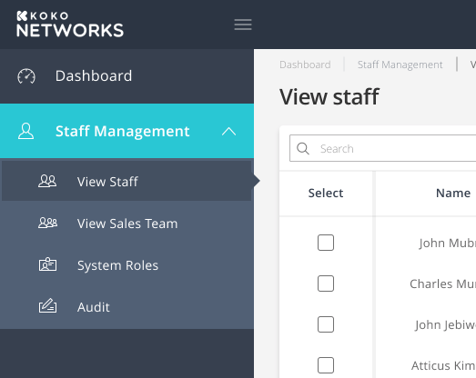
Main Menu
Staff section would be visible to user with permissions of Managing Users.
Pages under User Section:
View Staff -> All Managers team would be shown under it.
View Sales team -> All Team managed under Sales department would be listed in this section
Roles -> Section to manage roles for koko managers.
Audit -> Section to view all Audit logs for koko managers.

Slide 9
Create Staff - UX
Preview all details
Add Staff details
Add Roles
Add details of Customer account to be linked
Staff account created

Slide 10
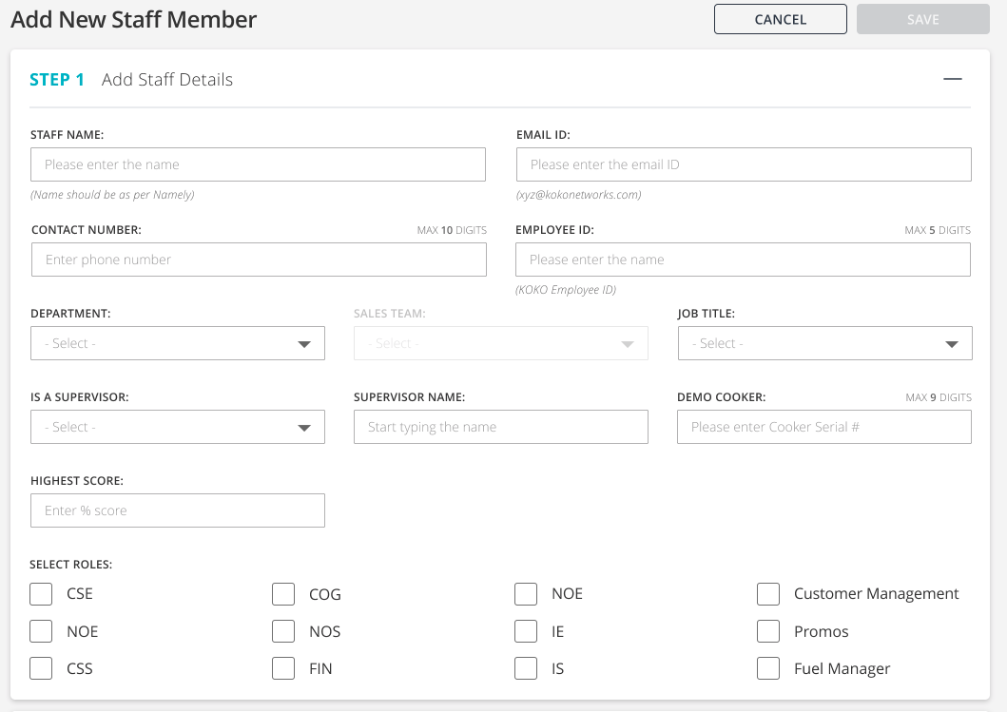
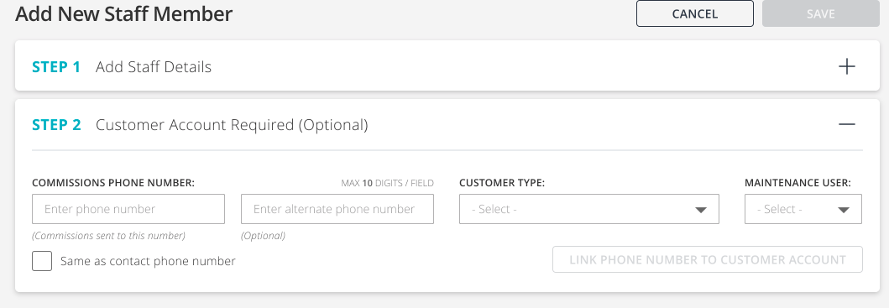
Create Staff - UI

Slide 11
View Sales Team
Create Teams
Edit Teams
View Staff members in team
Move Staff members to other teams

Slide 12
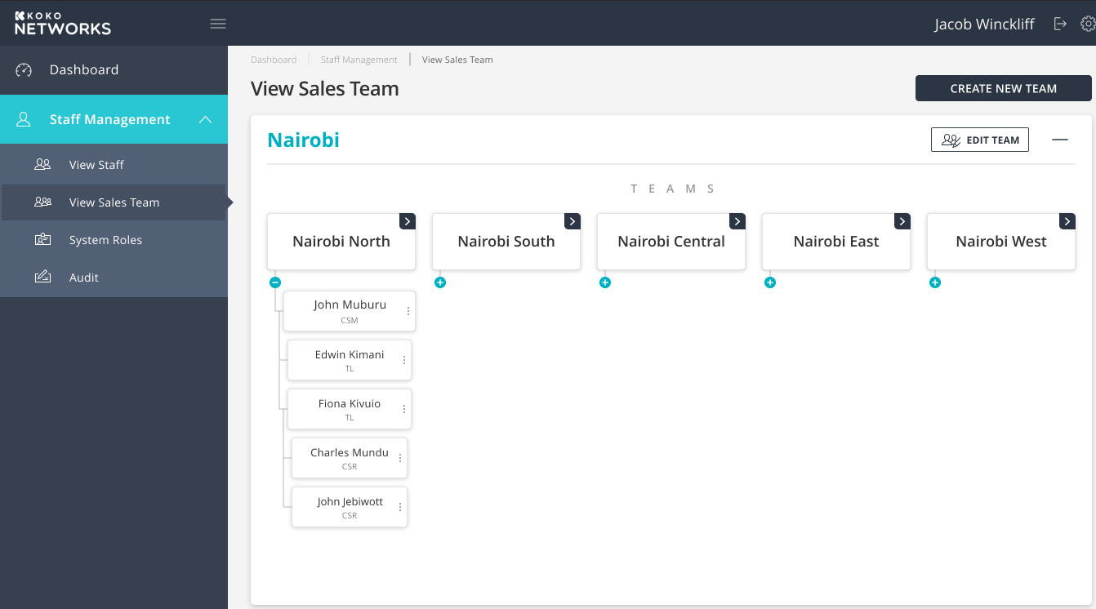
View Sales Team - UI
Wireframes - Link

Slide 13
Thank you

